Slide 1


Slide 2
Our Story
Developer of custom dry ingredients & seasoning blends
Servicing food manufacturing, food service and retail
customers
Veteran owned business, founded in 1982
Centrally located in Fremont, NE

Slide 3
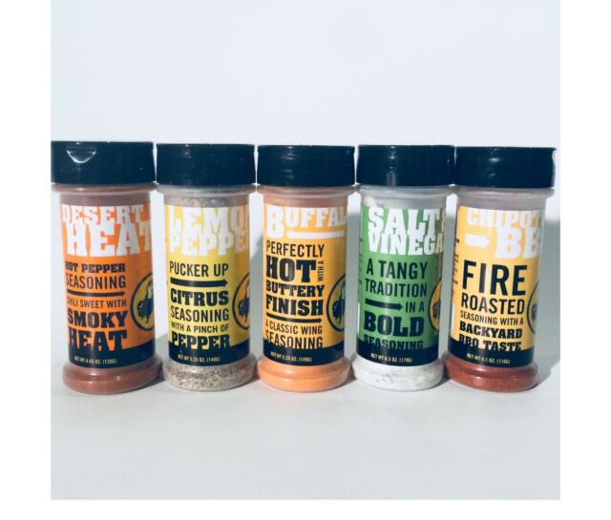
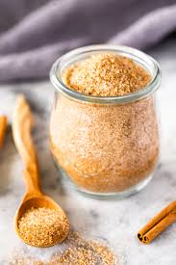


WBS Seasoning Blends
Buffalo Wild Wings Seasoning blends from around the globe.
Sold in poly bags for Back of House use and bottles for Front of the House home use!
Cinnamon & Sugar

Slide 4
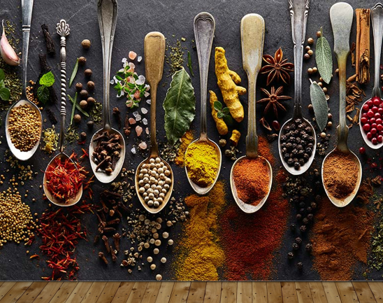

Global Flavor Ubiquity

Slide 5
International Spices Contacts
David Adam, V.P. Sales / Executive Chef
David.adam@Internationalspices.com
1040 Lucius St. Fremont, NE 68025
402-850-4629
Dennis Bishop, Owner
Dennis.bishop@Internationalspices.co
1040 Lucius St. Fremont, NE 68025
402-727-4600

